Slide 1
Socio-Economic Impact of Corona in Europe
Ironhack Bootcamp Data Analytics Final Project 18.12.2020
Daniel Tristram
Notes:
Analysis combines knowledge I had from Econometrics with modern Data Sciences tools I did learn during Bootcamp
As you´re all nontecnical audience I try staying away in slides from technical work done in background

Slide 2
Scope of Analysis
The influence of Corona on selected countries and socio-economic sectors is statistically evaluated using time series panel data
Type, strength and interdependence of examined indicators get checked
How can interactions between individual indicators be measured and dependence be visualized?
Answers to these questions are based on exploratory and inferential data analysis first. Second different multiple regression models are used to explain relationship and dependence

Slide 3
Scope of Analysis
13 European
Countries
8 Indicators
Total of
13.500
Datapoints
Inflation rate
Rental prices
Balance of payments
Trade by product group
Sentiment indicators economy
Unemployment rates total
Youth Unemployment rates under25
Slaughtering in slaughterhouses
Belgium
Bulgaria
Chekia
Germany
Denmark
Estonia
Greece
Spain
Finland
France
Hungary
Italia
Lithuania
Time Intervall
≈ 11 Years until 09/2020
Notes:
Overview shows that the countries used are quite different
Countries choosen by availability of data
In the short of time couldn´t look for more indicators from other sections of Eurostats
Slaughtering of Slaughterhouses took in cause had the thought that is has to be relatively immune to the impact of corona

Slide 4
Hypothesis researched
1
Corona has an impact in Youth Unemployment
2
Economic Sentiment Indicator has significant differences of means along the countries pictured
3
Economic Sentiment Indicator can be explained by the indicators used
4
Youth unemployment can be explained by indicators used
Notes:
2) Wanted to check the quality of the indicator
Composite indicator by surveys. Description sounded mysterious…
„Balances are contructed as the difference between the percentages of respondents giving positive and negative replies“ ….. Uiuiui

Slide 5
Project Timeline - Putting The Pieces Together
10.12.2020
Research of Indicators
Thursday
Prework: Developing
the database
Saturday
Explorative Data Analysis
Tuesday
Proof of Concept and Conclusion
Wednesday
17.12.2020
Notes:
Excel / Python
Prework: 38 countries in each table / Loads of cleaning necessary / Dealing with missing data for countries/Year/Indicator
Transposing Tables
Creating multi-level panel table: countries, Time, Indicators
One of the most actual open source panel dataframe related to corona ready to work with
- EDA: Lineplots, Barplot, Pieplot, Pivottable, Grouped tables, scatter plots, distribution plots, t-test, regression plots
Proof of concepts by 8 different regression models
Main focus on step by step multiple regression with statsmodels

Slide 6
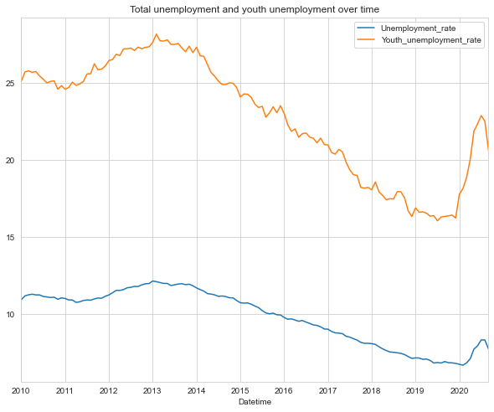
Getting Answers – Lineplot Youth Unemployment
2010: YU about 25%
TU about 11%
The peak of youth unemloyment is seen at beginning 2014 with nearly 30%.
until end of 2019 both curves fell relatively evenly, to a level of about 4% total, and 16% Youth unemployment
In 2020 the curve of Youth unemployment rises sharply, by 6% from 17% to 23%, while the total unemployment, rises, but not as strong
H0 != 0 → rejected H1 == 1 → Hypothesis approved
Aggregated Youth/Total Unemployment in researched countries
Notes:
2008/2009 financial crisis
Proved this Hypothesis only visually cause lack of time
Prove by T-test easy possible with paneldata. Take 2020 and compare. Did this with Sentiment indicator
Dataset is great to compare 13 countries on a base like that.
You can pick every month datapoint for 11 years out of dataset for 13 countries to compare

Slide 7
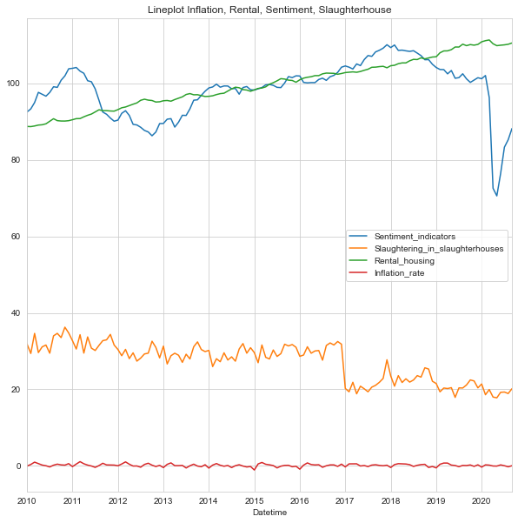
Getting Answers – Lineplot Rental Housing
The economic sentiment index falls dramatically at the beginning of lockdown February/March 2020
From a socio-economic perspective, the line diagram shows a development caused by Corona, which has a major impact on large parts of society
The green line of rental prices has a very linear gradient. Beginning 2020 it drops slightly, but recovered quickly
On the other hand we have higher unemployment rate since Corona, people who are in job have less income due to short-term work
Lineplot shows tendency to rising imbalances in the European population. Of course is this lineplot on a very high aggregation level, but some important to watch on
Notes:
- Slaughterhauses not got effected strong by Coronavirus. I had this in mind before seeing this plot. Europe had the same population during lockdown.
Less tourists coming to Europe for holidays from abroad but on other hand few european citizenz leaving Europe to abroad in that time
- Inflation rate does not get pictured good in this plot. Has by itself a very small variance, apart from countries with Hyperinflation.

Slide 8
Pie Chart – Visualising relative Shares of mean Unemployment on Countrylevel in time-period
Notes:
Graphic pictures relative mean shares of unemployment per country over time
Ist not the % unemployment by population of each country
All countries == 100%
Grafic is highly aggregated
With the dataset ist easy to do the same on country level by year or month.

Slide 9
Panel Analysis with Multiple Regression on Youth Unemployment – how does it work?
Data Indicator
Slaughtering in Slaughterhouses
Trade Volume
Rental Housing
Economic Sentiment Indicator
Balance Payments
Result
Notes:
You throw every datapoint from each data inside the funnel
and implement a quite easy mathmatical formula ;)
I took out inflation rate. Had no impact
Took out total unemployment as well. Model unvalid with the indicator!
Im Folgenden wird von linearen Funktionen ausgegangen. Es ist dann keine weitere Beschränkung der Allgemeinheit, dass diese Funktionen direkt aus den unabhängigen (erklärenden, exogenen) Variablen bestehen und es ebenso viele zu schätzende Regressionsparameter β k {\displaystyle \beta _{k}} gibt wie unabhängige Variablen x k {\displaystyle x_{k}} (Index k = 1 , 2 , … , K {\displaystyle k=1,2,\dots ,K} ). Zum Vergleich: In der einfachen linearen Regression ist K = 2 {\displaystyle K=2} und x 1 {\displaystyle x_{1}} konstant gleich 1 {\displaystyle 1} , der zugehörige Regressionsparameter also der Achsenabschnitt.

Slide 10
Multiple Regression on Youth Unemployment – Visualizing the Results
In last step 80% of all 13.500 Datapoints are explained by the model
80%
79,5%
36,5%
34,5%
30%
Enhancing the model by adding the right Indicators
H0 != 0, H0 gets rejected H1 == 1, H1 is proved
The independent variables used in multiple regression are on a 95% significance level valid to explain
Youth Unemployment rate. Proof of Concept by critical value F-Distribution
Notes:
F-Distribution
A measure how significant the fit is. The mean squared error of the model divided by the mean squared error of the residuals
on a 95% significance Nivau
critical value for Degrees of Freedom 1671 and 6: 2,11
in the valid model of iteration 6 we do have F-distribution of: F-statistic: 1.094
The value of used regression model is smaller than critical value

Slide 11
At a glance – Results of the examined hypotheses
1
Corona has an impact in Youth Unemployment:
H1 prooved by visualisation
2
Economic Sentiment Indicator has significant differences of means: H1 prooved, by one sided t-test
3
Economic Sentiment Indicator can be explained by the indicators used: H0 prooved, model does not explain SI
4
Youth unemployment can be explained by indicators used in multiple regression: H1 prooved

Slide 12
Socio-Economic Impact of Corona in Europe
Ironhack Bootcamp Data Analytics Final Project 18.12.2020
Daniel Tristram
?
Do you have any questions?
?
?

